Slide 1



Members Names | CMS
Hamza Siddique | 20844
Mujahid Qayyum | 20648
Ahmed Nadeem | 20845
Sikander Khan | 19375
Qasim Raheem | 20645

Slide 2
Trade
What is trade?
The action of buying and selling goods and services.
Why we trade?
We trade because we cannot satisfy our needs, so we depends on others to fulfill our needs.
Our needs are food, cloth, shoes, home, furniture and etc.

Slide 3

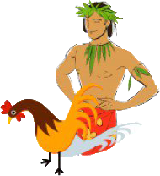
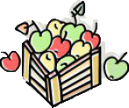
Start of Trade
Take my fruits and give me your chicken.
Okay !!!

Slide 4

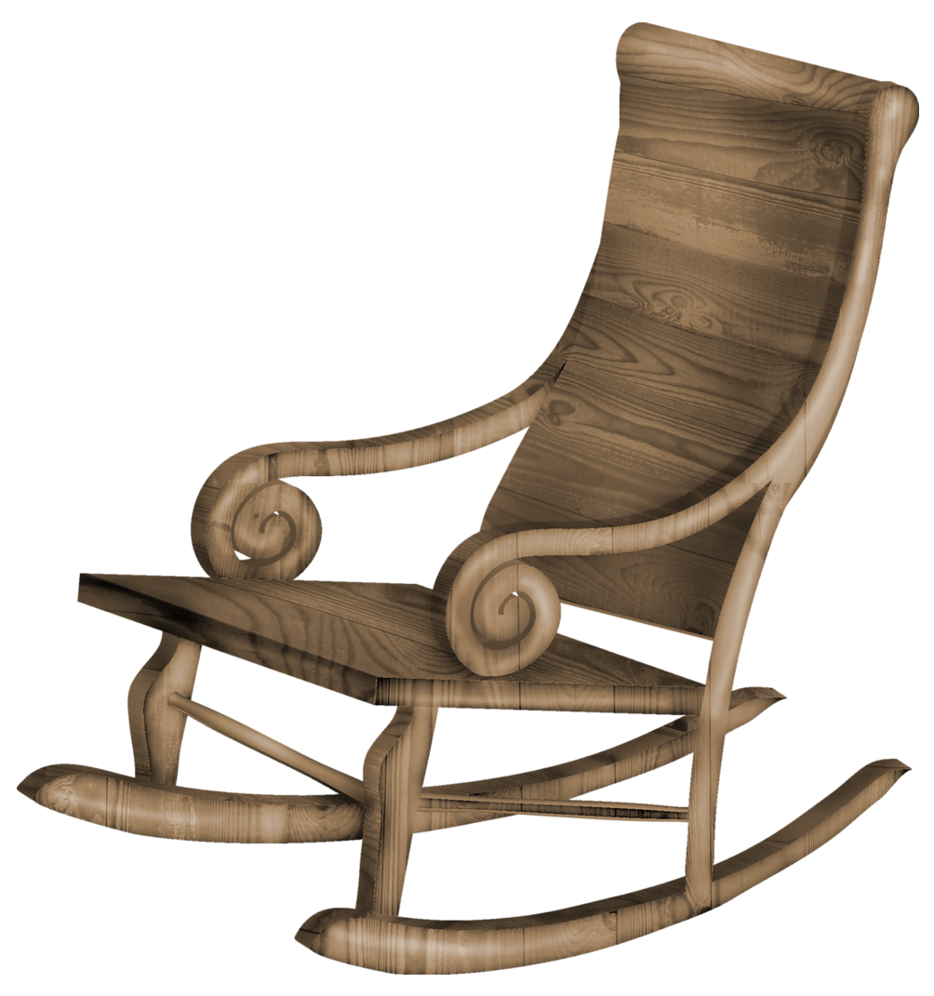

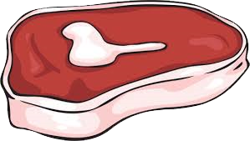

Trade of Goods
Exchange goods for goods

Slide 5
But got some problems
Cannot trade for long distance because some goods spoils.
Robbers rob them in routes.
Animals dies in routes.
Don’t have chance of saving or buy after some long time.

Slide 6

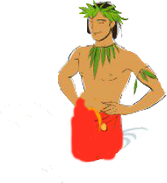
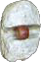
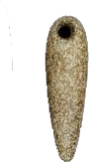
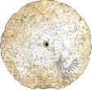
Start of shell or stones trade
Trading with specials stones, can save for other goods

Slide 7
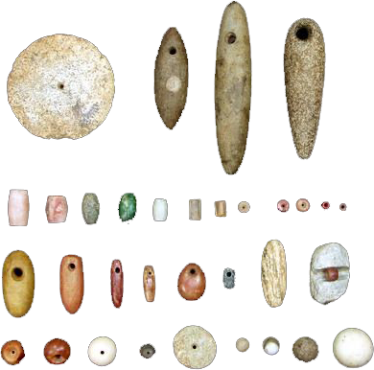
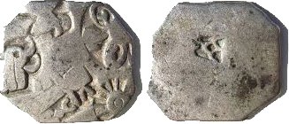
Some stones coins

Slide 8
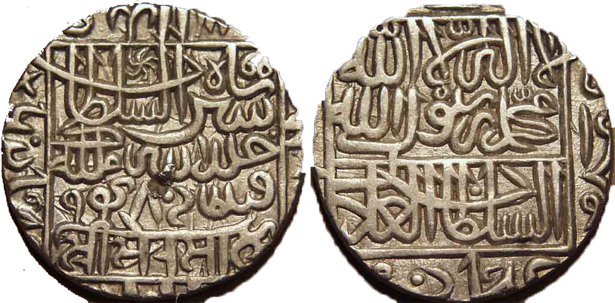
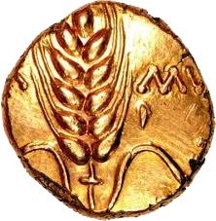
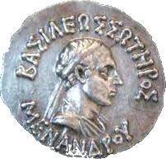
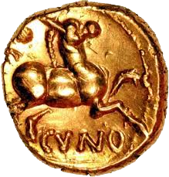
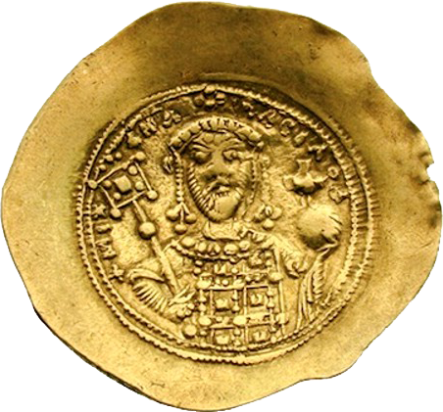
Replacement with Coins

Slide 9
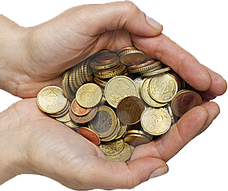
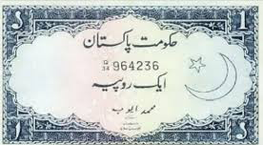
Merge of many coins to light paper note

Slide 10
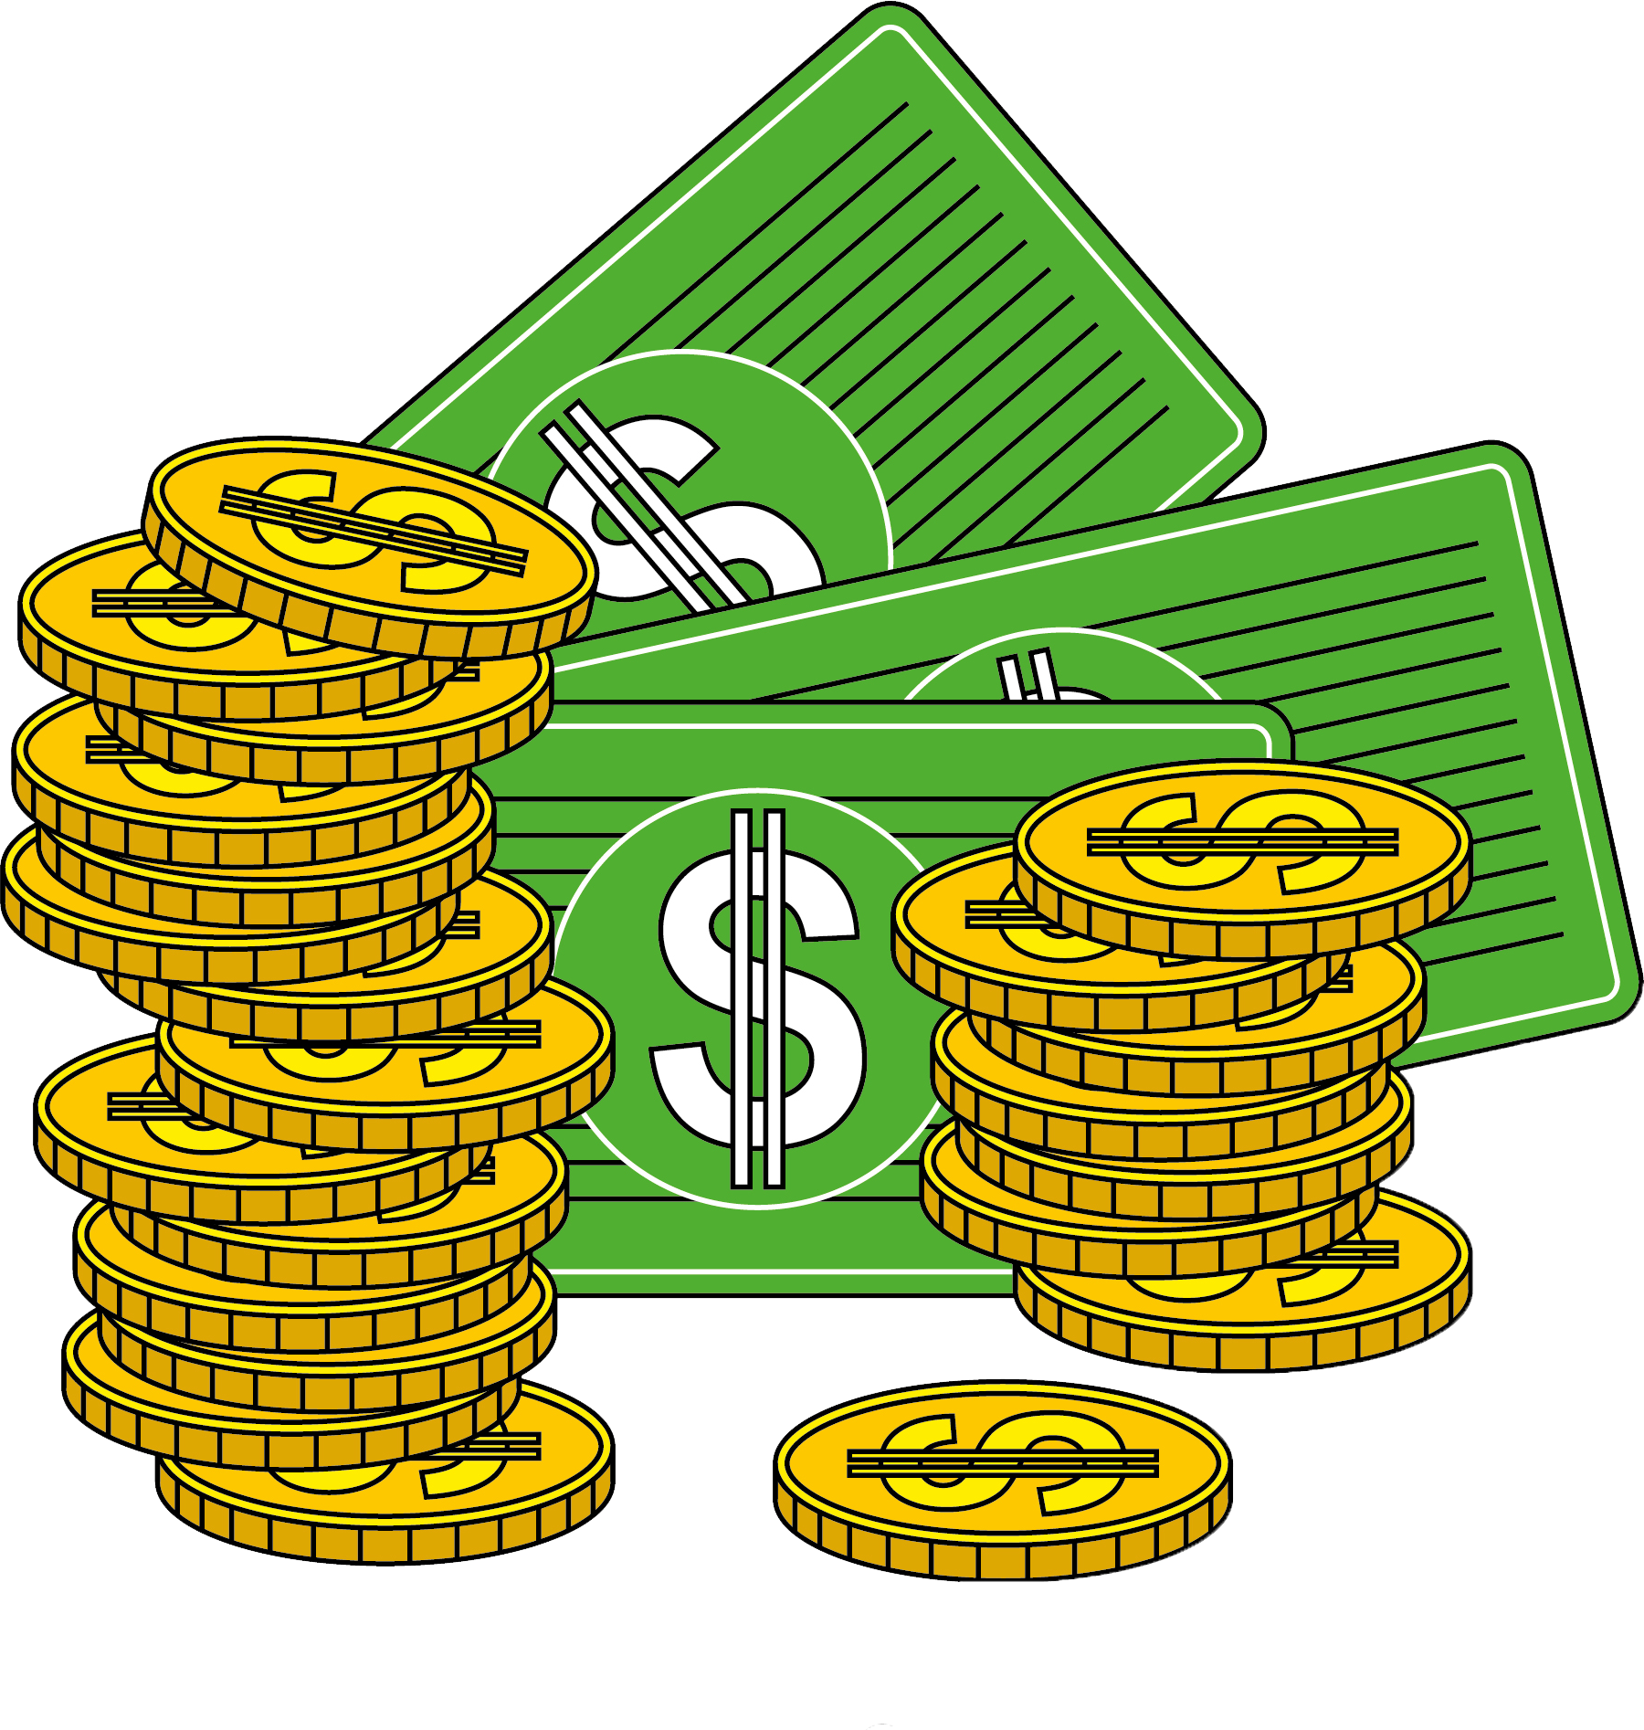
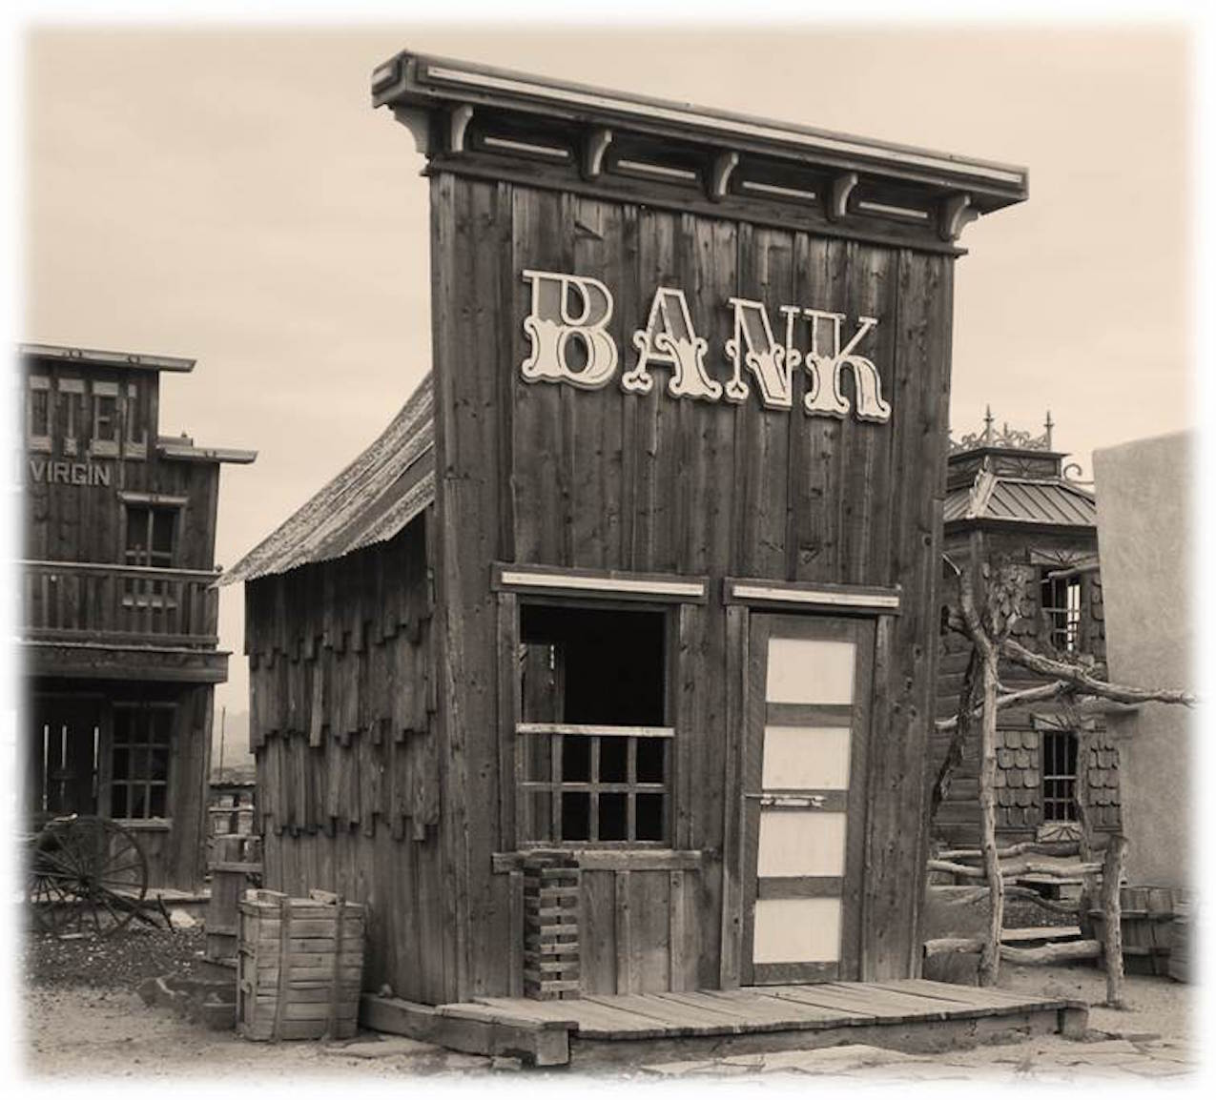
Many money saves into Banks

Slide 11
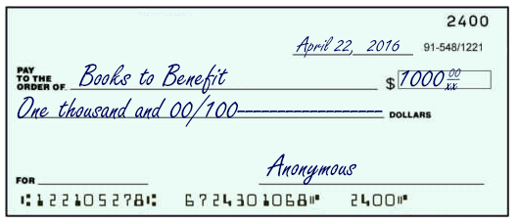
Checks books
Check is a document that orders a bank to pay a specific amount of money from a person's account to the person in whose name the check has been issued.

Slide 12
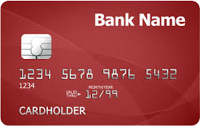
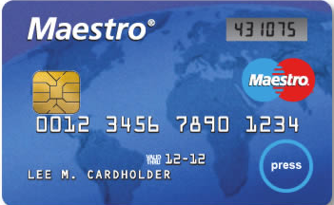
Credit cards
A credit card is issued by a credit card provider, like Capital One, and they are designed to pay for things in shops or online. You can also use credit cards for balance transfers and taking out cash (also known as cash advance or cash withdrawal) from an ATM.

Slide 13
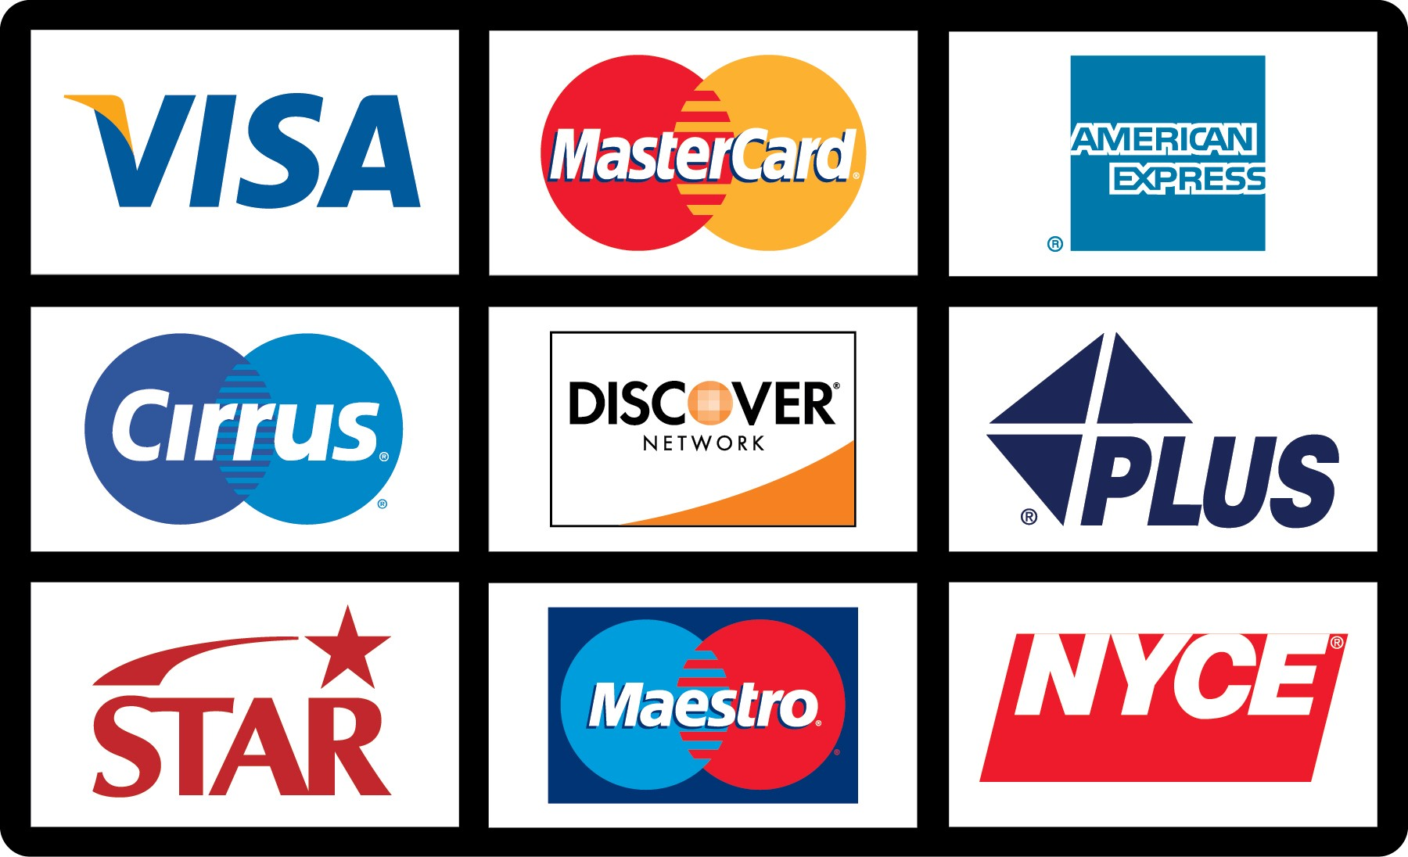
Payment Gateways
A payment gateway is a merchant service provided by an e-commerce application service provider that authorizes credit card or direct payments processing for e-businesses, online payment.

Slide 14
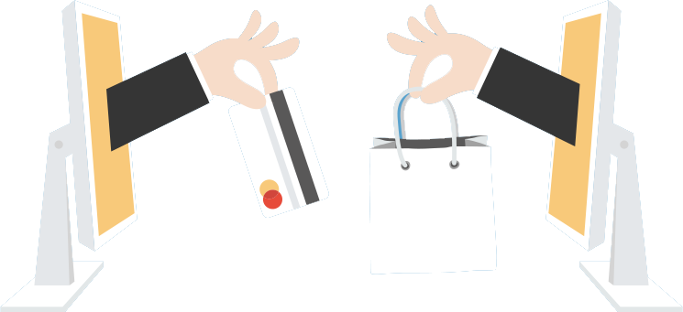
Payment Gateway
Online Payment

Slide 15
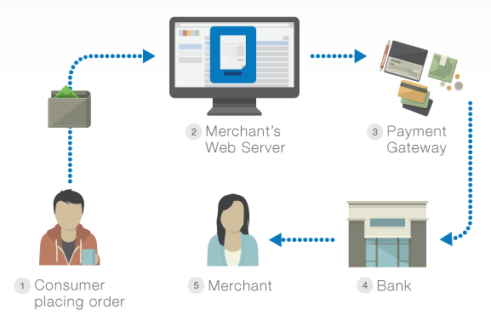
Payment Gateway

Slide 16

BitCoins Trade
What is BitCoin?
A type of digital currency in which encryption techniques are used to regulate the generation of units of currency and verify the transfer of funds, operating independently of a central bank.

Slide 17
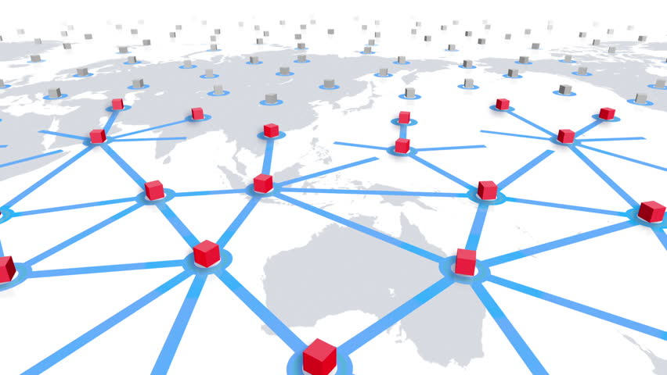
YOU CAN SEND THROUGH THE INTERNET

Slide 18

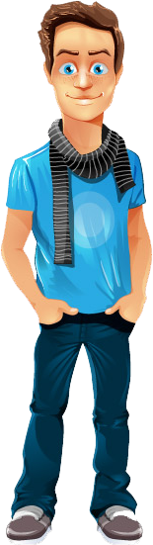

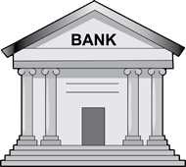
Bitcoins have numbers of Advantages

Slide 19

2.9%+0.3$
0.01$
Lower fees

Slide 20

You can use them in every Country

Slide 21


And there are no records or limits

Slide 22
Bitcoins are generated all over the internet, by any body running a free application called bitcoin miner.

Slide 23
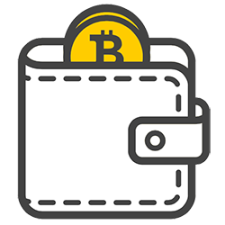
Your bitcoins are stored in your digital wallet

Slide 24

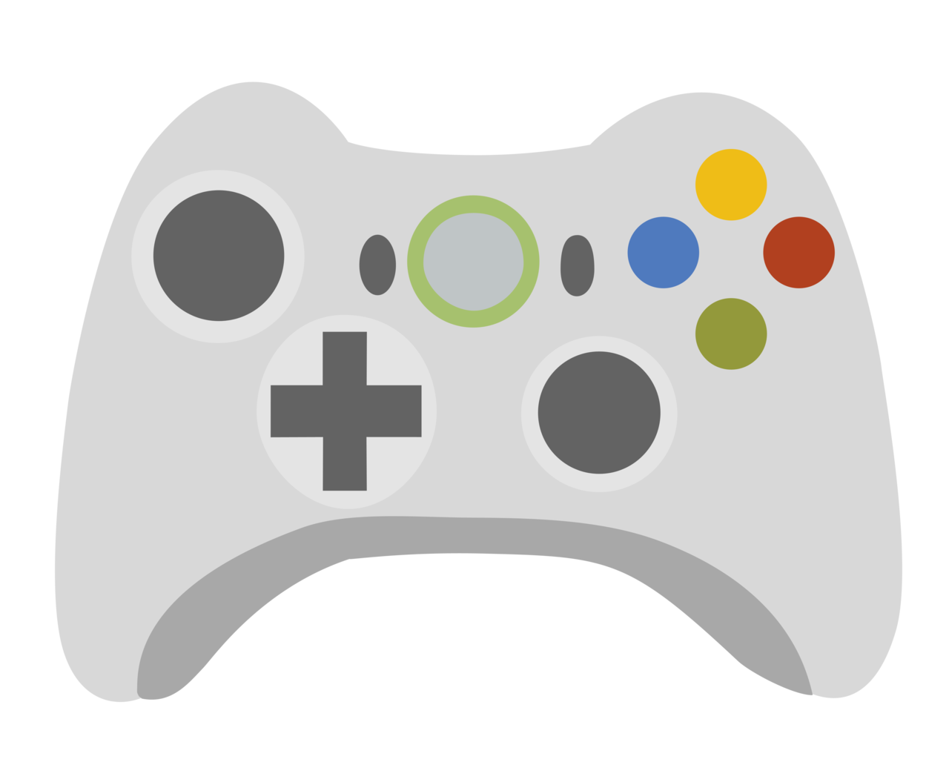
You can purchase Video games

Slide 25
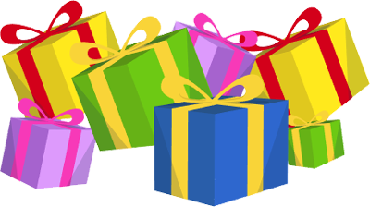
Gifts

Slide 26

books

Slide 27




You can exchange your bitcoins into several currencies

Slide 28
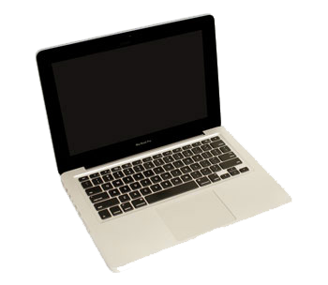
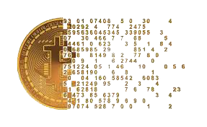
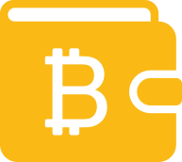
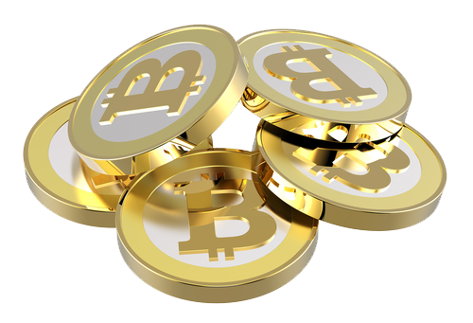

Slide 29
So Keep Moving Forward!
Thankyou

